Slide 1
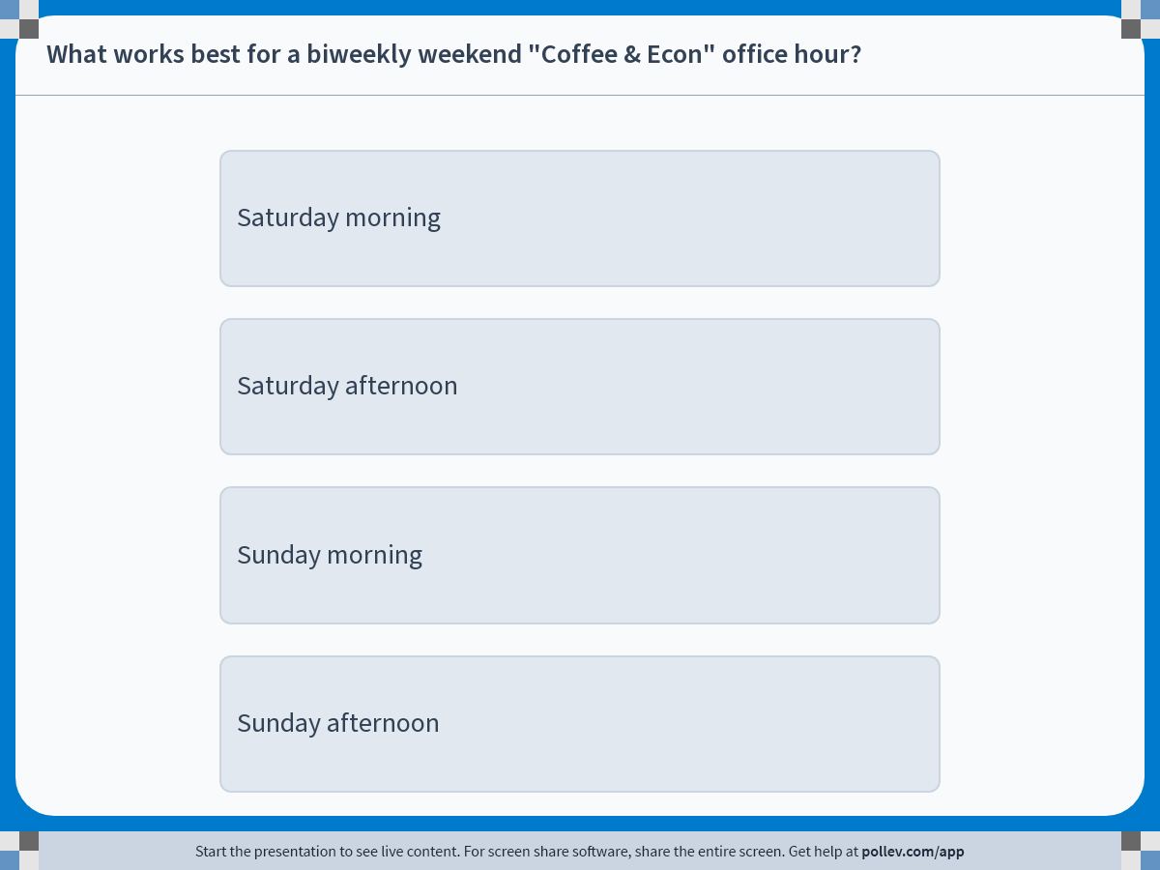
Notes:
Poll Title: Do not modify the notes in this section to avoid tampering with the Poll Everywhere activity. More info at polleverywhere.com/support What works best for a biweekly weekend "Coffee & Econ" office hour? https://www.polleverywhere.com/multiple_choice_polls/YrpUP8E2bQwQEmDPKwbfG?display_state=instructions&activity_state=opened&state=opened&flow=Engagement&onscreen=persist

Slide 2
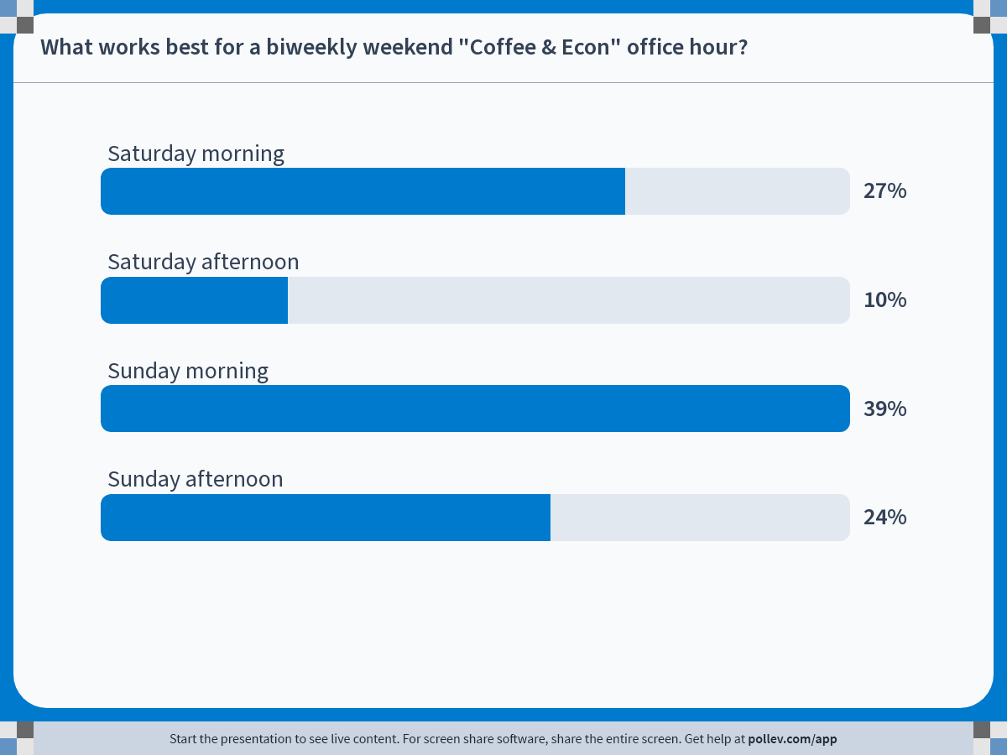
Notes:
Poll Title: Do not modify the notes in this section to avoid tampering with the Poll Everywhere activity. More info at polleverywhere.com/support What works best for a biweekly weekend "Coffee & Econ" office hour? https://www.polleverywhere.com/multiple_choice_polls/YrpUP8E2bQwQEmDPKwbfG?display_state=chart&activity_state=opened&state=opened&flow=Engagement&onscreen=persist

Slide 3
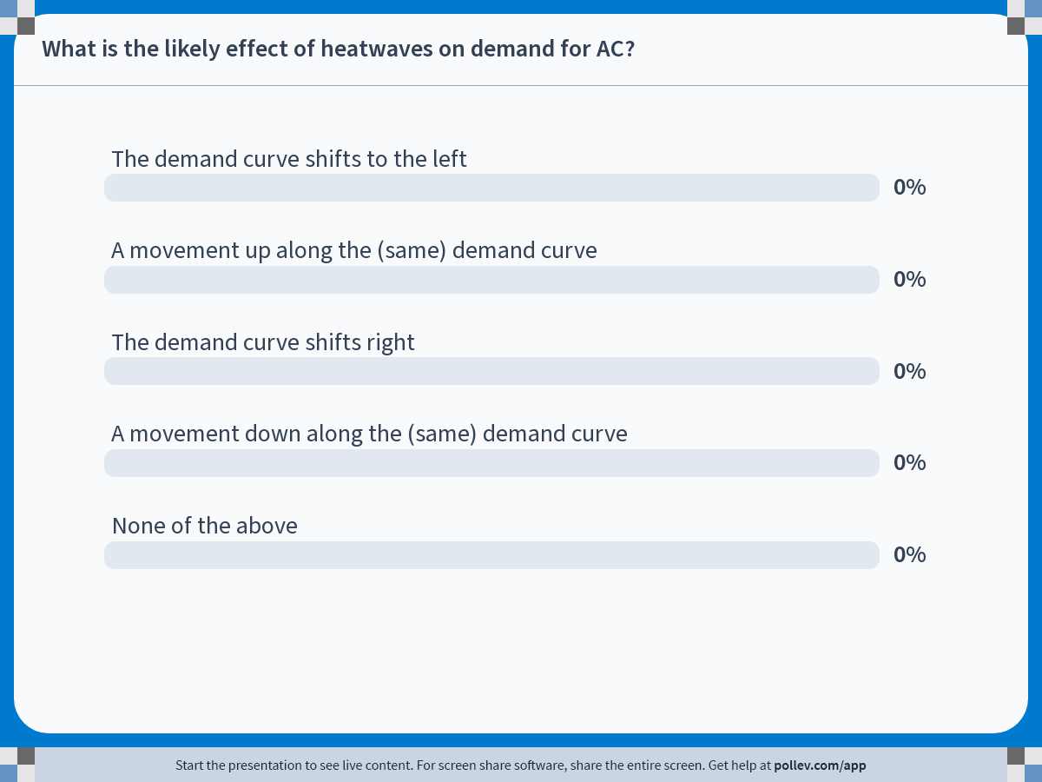
Notes:
Poll Title: Do not modify the notes in this section to avoid tampering with the Poll Everywhere activity. More info at polleverywhere.com/support What is the likely effect of heatwaves on demand for AC? https://www.polleverywhere.com/multiple_choice_polls/ABiR2oTb0P824JepooJVN?display_state=chart&activity_state=closed&state=closed&flow=Instructor&onscreen=persist

Slide 4
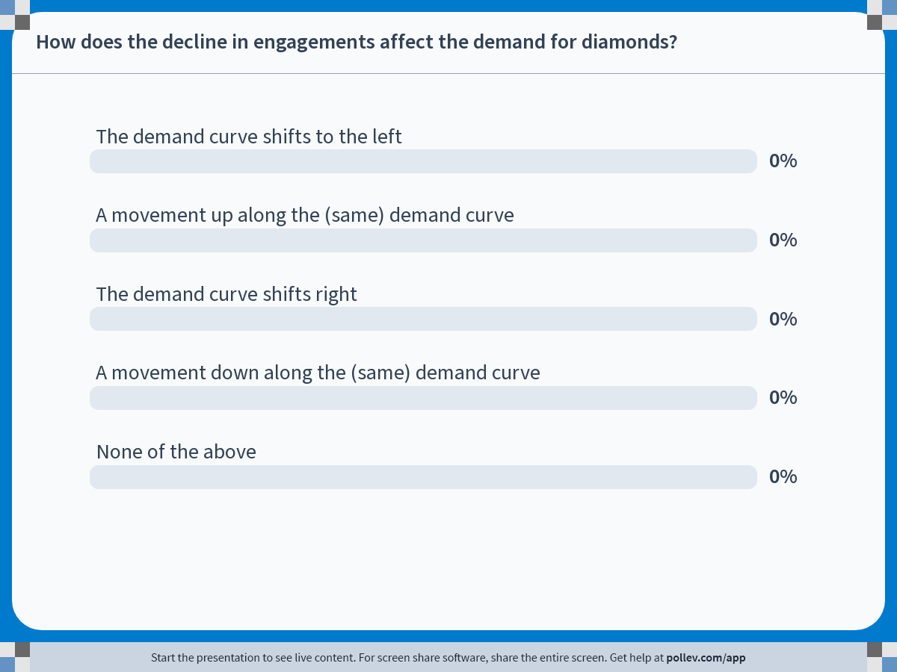
Notes:
Poll Title: Do not modify the notes in this section to avoid tampering with the Poll Everywhere activity. More info at polleverywhere.com/support How does the decline in engagements affect the demand for diamonds? https://www.polleverywhere.com/multiple_choice_polls/a2xl314BB0WnEchwmjvzh?display_state=chart&activity_state=closed&state=closed&flow=Instructor&onscreen=persist

Slide 5
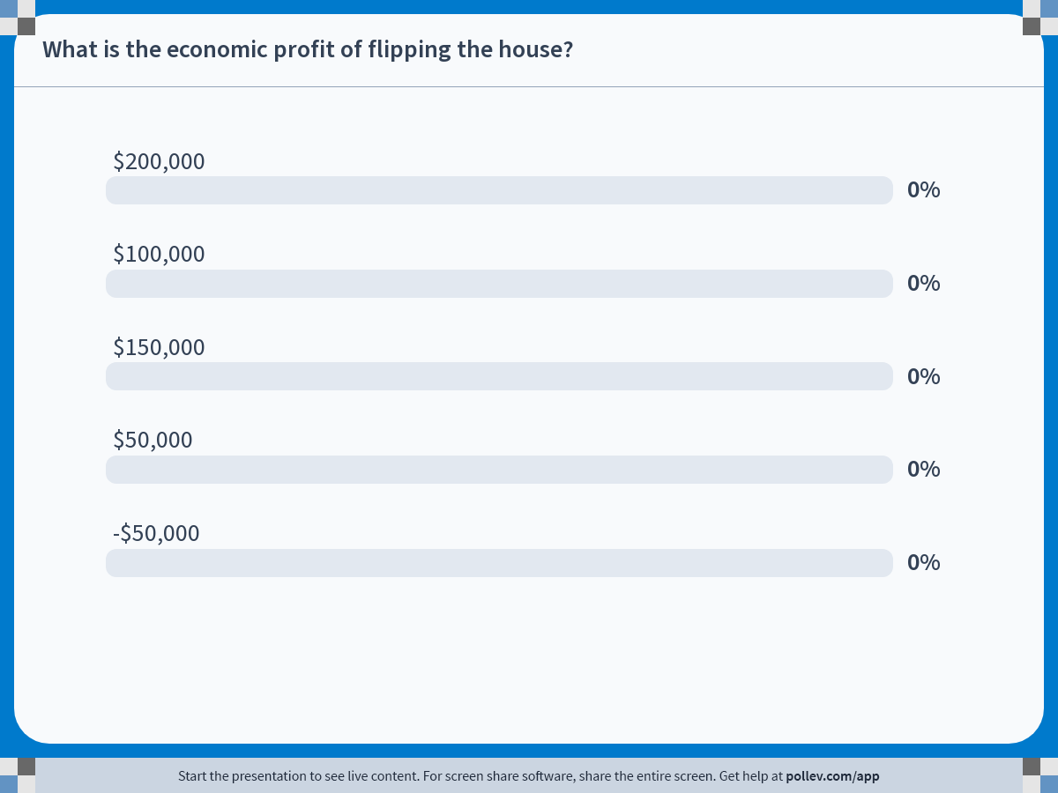
Notes:
Poll Title: Do not modify the notes in this section to avoid tampering with the Poll Everywhere activity. More info at polleverywhere.com/support What is the economic profit of flipping the house? https://www.polleverywhere.com/multiple_choice_polls/jgN2yjFR118rTG1t1KiMN?display_state=chart&activity_state=closed&state=closed&flow=Instructor&onscreen=persist

